Slide 1
Welcome

Slide 2
“Redefining Secure Web Solutions with Ethics and Privacy”
Md Mehedi Hasan Polash
Id:22-46566-1
Department of computer science and engineering(CSE)
Subject :Engineering
Ethics,
Section: B

Slide 3

About us
Overview:
We are a startup focused on developing ethical and secure web solutions that put user privacy at the forefront. Our dedicated team of developers, security experts, and privacy advocates strives to create innovative technologies that safeguard user data and build trust in the digital world.
Mission:
To design and deliver web solutions that prioritize security, empower users, and uphold ethical standards in every aspect of technology.
Vision:
To create a digital future where user privacy is guaranteed, data protection is the norm, and trust forms the foundation of all online interactions.

Slide 4

Our Core Values
Ethics:
We uphold transparency and honesty, fostering trust in all we do.
Security:
We build secure systems to safeguard user data against threats.
Innovation:
We leverage technology to empower users ethically and effectively.
Responsibility:
We ensure data privacy and comply with global standards to protect user rights.

Slide 5
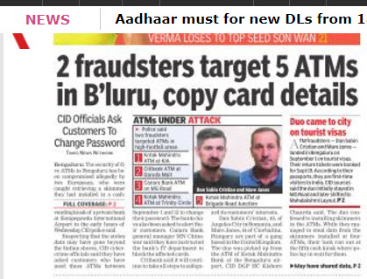
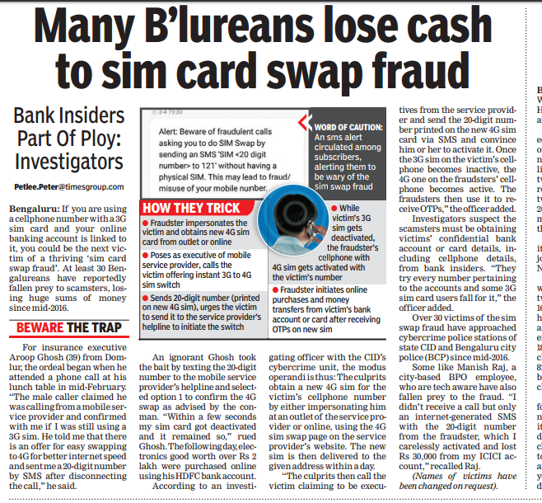
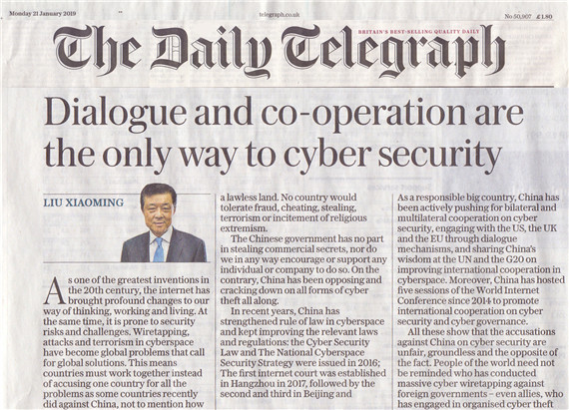
Recent Incidents Stressing the Need for Secure Web Practices

Slide 6
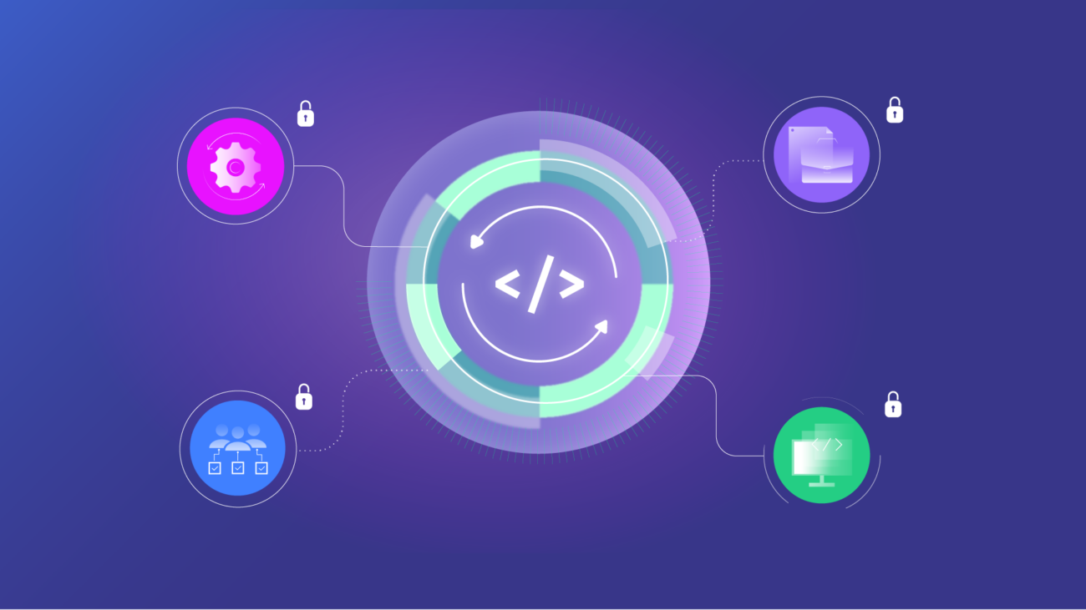
How We Operate
Agile Development:
We follow an agile, user-centered approach to deliver tailored and efficient solutions.
Security Collaboration:
We work with ethical hackers to identify and fix vulnerabilities, ensuring robust security.
Compliance Audits:
Regular audits ensure our solutions align with data protection laws like GDPR and CCPA, guaranteeing user privacy.

Slide 7

Our services
Secure Web Development: We build websites and applications with integrated security features to protect against online threats and ensure data privacy.
Data Protection Solutions: Our services include encryption, secure data storage, and anonymization to safeguard sensitive information.
Consulting: We help businesses navigate data privacy regulations and ensure compliance to protect customer trust and avoid legal issues.

Slide 8

Technology Stack
Languages: PHP, JavaScript, Python (for backend and frontend development).
Security Tools: OWASP security standards, SSL/TLS encryption, firewalls.
Frameworks: React.js, Laravel, Django (tailored to your project needs).
Cloud Platforms: AWS, Google Cloud, or Azure for secure and scalable deployments.

Slide 9

Our Ethical Code
Transparency: Open practices in how we handle and store user data.
Regulatory Compliance: Adherence to international laws such as GDPR, CCPA.
Inclusivity: Designing solutions that are accessible to all.
Uncompromising Security: Never sacrificing data security, no matter the challenge.

Slide 10

Data privacy & commitment
End-to-End Encryption: We ensure that sensitive data remains fully encrypted, protecting it from unauthorized access at every stage of transmission and storage.
No Tracking Without Consent: Our policy is transparent—data collection and tracking are only done with explicit user consent, and users can easily opt out at any time.
Continuous Security Updates: We implement regular updates and patching to stay ahead of evolving threats, ensuring ongoing protection against vulnerabilities.

Slide 11
Future Goals
Expansion: Introducing new services and entering new markets to reach more business.
R & D:Exploring AI and blockchain to advance data privacy and sequirity.
Community : Building a network of like-minded developers to dive ethical web practices.

Slide 12
Thank you!
Md Mehedi Hasan Polash polashmehedi33@gmail.com

